Slide 1
Career Connections
May 2018

Slide 2

http://www.self-directed-search.com/Who-uses-it/Students-Parents
Notes:
https://www.youtube.com/watch?v=qW_LLj9mcbg

Slide 3
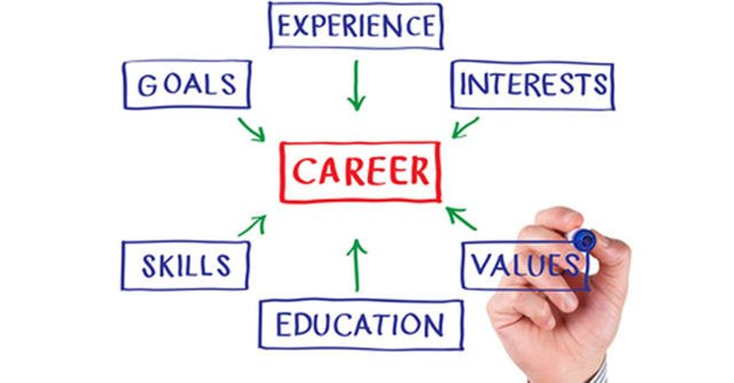
Notes:
Simply put, career advising is the sum of the activities completed through counselors, teachers, and administrators that help align a student’s goals, experience, interests, values, skills and education to his or her desired career.
(OR)
In order to consider the why and how of integrating career advising in academic advising, it is important to clearly define career advising. Virginia Gordon (2006) describes it as a dynamic, interactive process that “helps students understand how their personal interests, abilities, and values might predict success in the academic and career fields they are considering and how to form their academic and career goals accordingly” (p.12). It is different from the more psychologically intense career counseling that seeks to assist students with the complex career-related personal concerns. (Gordon, 2006). - See more at: http://www.nacada.ksu.edu/Resources/Clearinghouse/View-Articles/Integrating-career-and-academic-advising.aspx#sthash.6k1asrdF.dpuf

Slide 4
Career Advising
Creates relevance and purpose in the classroom
Identifies career interests so students can make informed decisions
Promotes postsecondary awareness, access and completion
Maintains engagement, focus and motivation

Slide 5
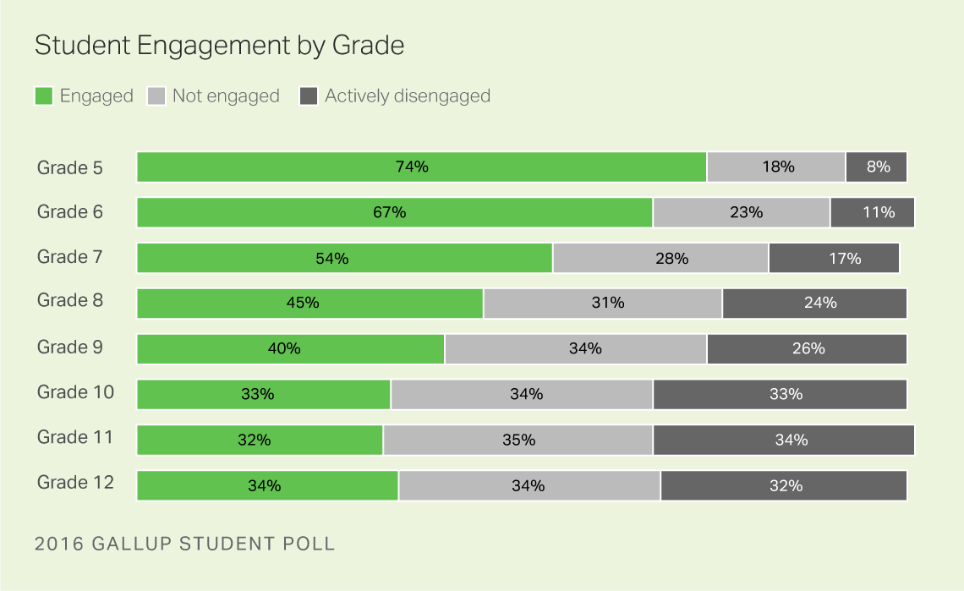
http://news.gallup.com/reports/210995/gallup-student-poll-snapshot-report-2016.aspx
Notes:
The middle grades offer a unique opportunity for CTE to increase involvement, and research tells us this is a vital time to engage students. Gallup’s recent poll on student engagement shows a dramatic decrease between grades 6 through 12, but notice the big drops between grades 6, 7, and 8. So what increases student engagement?
According to the Association for Middle Level Learners, involvement in hands-on activities, exploring what they are interested in, and a connection between what they are doing in school and the real world are the keys to getting students engaged. (http://www.amle.org/BrowsebyTopic/WhatsNew/WNDet/TabId/270/ArtMID/888/ArticleID/508/The-Apprenticeship-Approach.aspx)
This is what CTE does best! In this session, we’ll share several strategies and resources that position CTE as the leaders in career connections for all your associate schools.
The sooner students begin to learn more about themselves and what they do best, the more prepared they will be to use their strengths to benefit their future workplaces and communities.
Students explore their career interests through embedded activities. Career exploration strategies are opportunities for students to discover work environments and understand the various aspects of the workplace. Strategies include tools and instruments that help students understand and appreciate their strengths and interests. Students start plans for their future with career information and postsecondary education data. Plans include course selection and planning as well as career aspirations and goals.

Slide 6
components in the Career Advising Policy
Notes:
The policy consists of eight components with noticeable commonalities among three topics – pathways, individualized planning, and student learning.

Slide 7
1
Career Connections Learning Strategies
Notes:
The first component of the policy on career advising is providing grade-level strategies that link student coursework to career fields.
Schools may use the career connections learning strategies provided by the department in the model curricula … or develop their own strategies that help students see and understand the relevance of their learning to future career options.

Slide 8
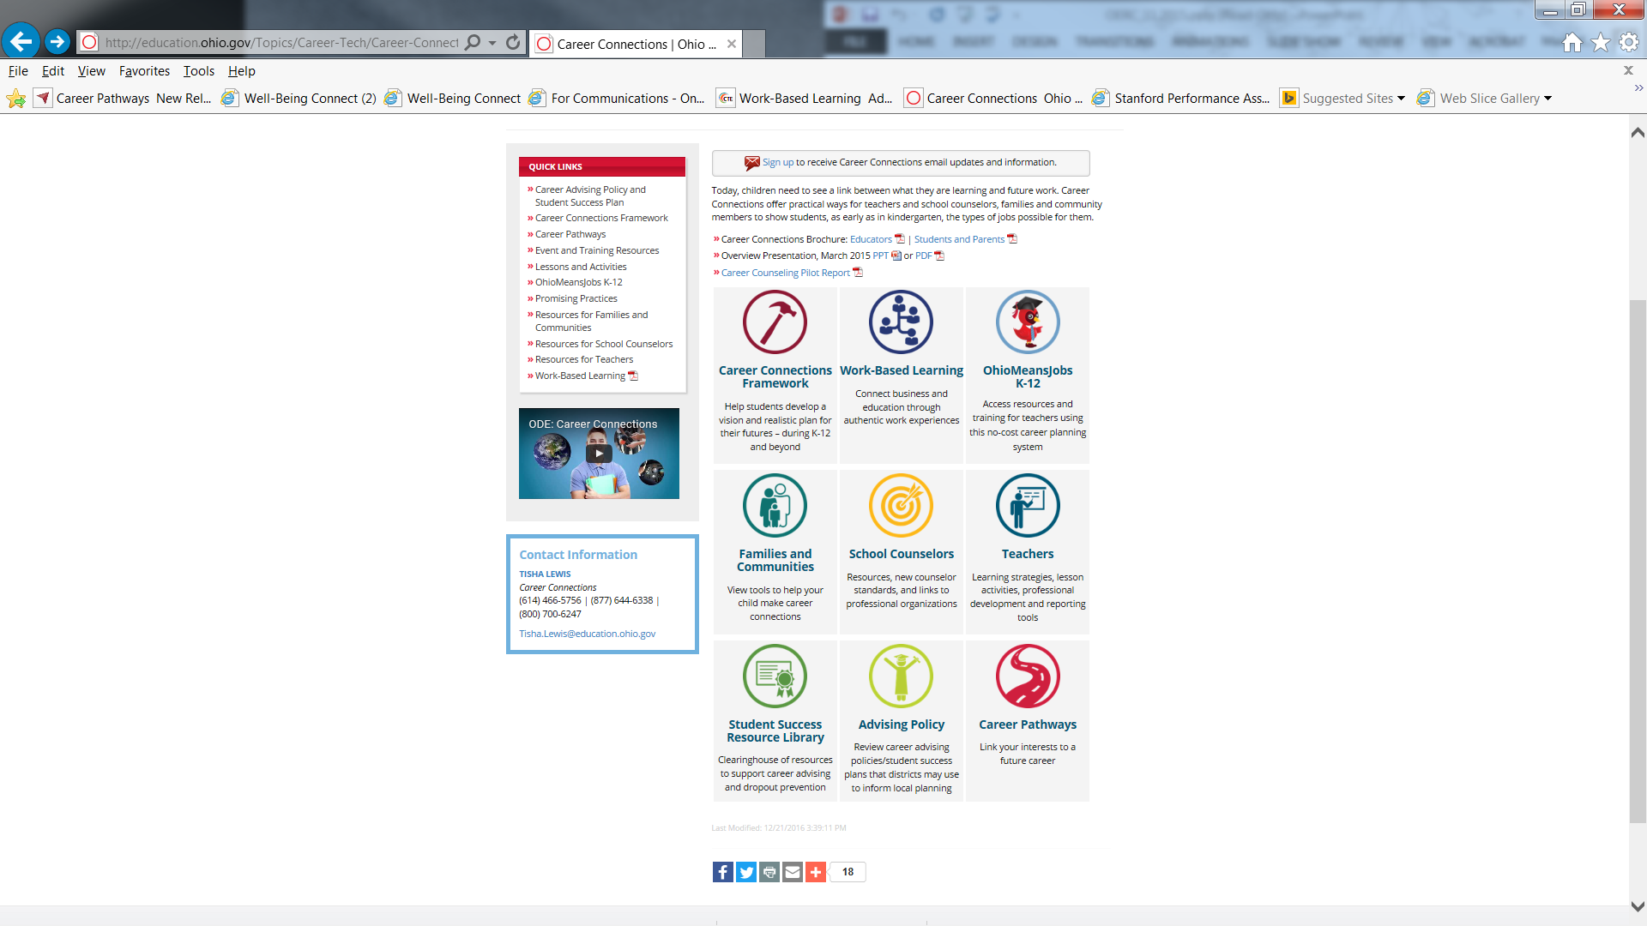
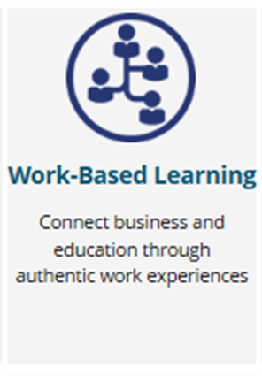
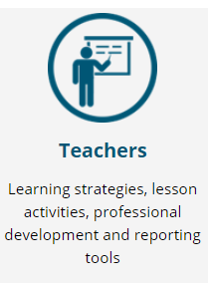
Teacher Resources

Slide 9

Classroom Resources
Career Connections Learning Strategies
  Ohio Department of Education Model Curricula
  Teacher Guide for Adapting Local Curriculum
  K-12 Searchable Lessons and Activities
Notes:
Reference the “additional resources” document to find various resources to support career connections learning strategies

Slide 10
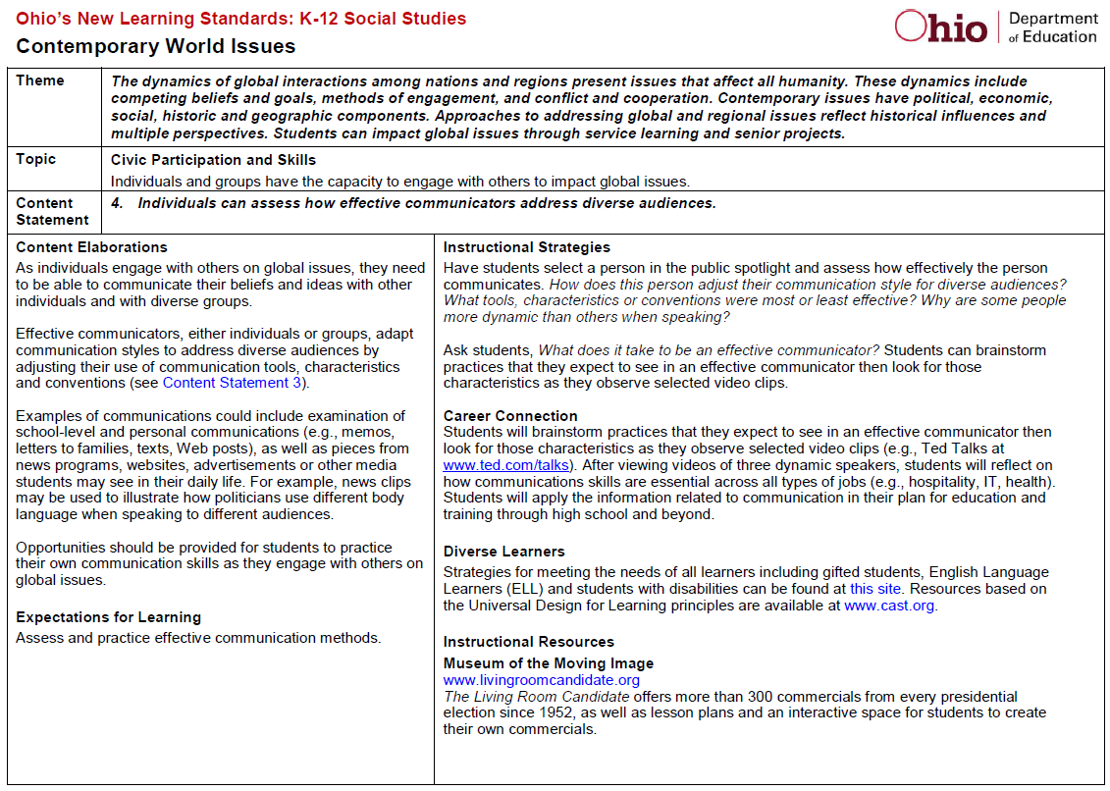
Model Curricula
Notes:
Explain the model curriculum available and reference audience to the ODE site for specific curriculum by grade level and by subject.
ELA and Math standards are being aligned with each CTE career field standard to identify areas where the content can be taught in multiple subjects. A mapping tool will be provided through the work with the NSFY grant in the next year.

Slide 11

Guide for Teachers
Lead-in
Student Action
Reflection
Notes:
A way for teachers to modify standards to implement learning strategies
How does this fit in to what I’m already teaching? Consider one of these approaches when planning your next unit.
LEAD-IN: Introductory activity that establishes career connections (e.g., simulation or real-work problem based upon the academic knowledge or skill)
STUDENT ACTION: A project or assignment where students apply Career Connections (e.g., identifying a real-work problem, then researching and developing a solution using academic knowledge and skills)
REFLECTION: A follow-up activity or discussion that emphasizes Career Connections (e.g., group or individual response analyzing application of academic knowledge and skills to real-work scenarios)
“A Career Connections Guide for Teachers” Handout from department website: http://education.ohio.gov/getattachment/Topics/Career-Tech/Career-Connections/Resources-for-Teachers/Career-Connections-Guide-Teacher_4-2014.pdf.aspx

Slide 12
2
Career Advising
for Students in
Grades 6-12
Notes:
The second component of the policy on career advising is providing career advising to students in grades 6 through 12.
Schools will determine the frequency of student interaction and the type of career advising activities provided based upon student need.

Slide 13
Career Connections Framework

Slide 14
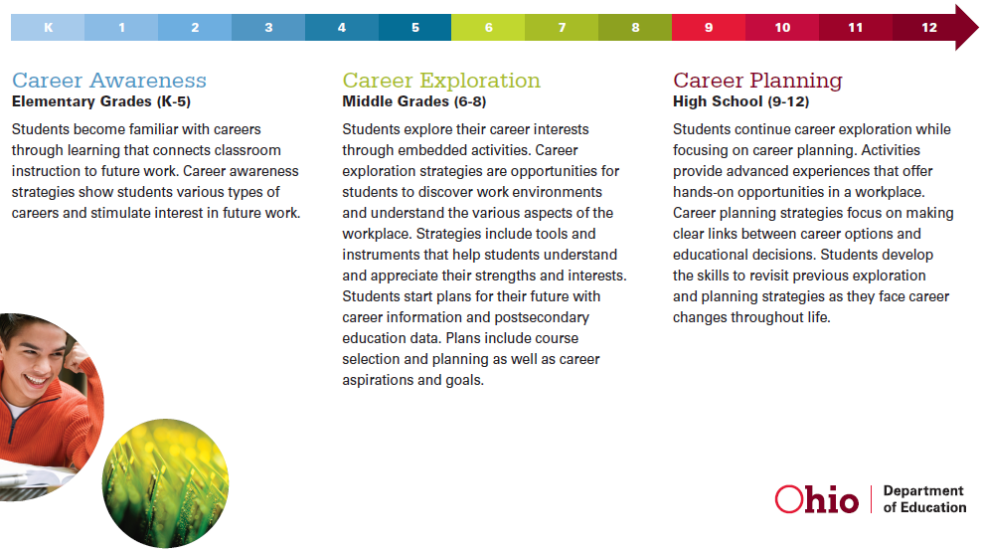
Career Connections Framework

Slide 15
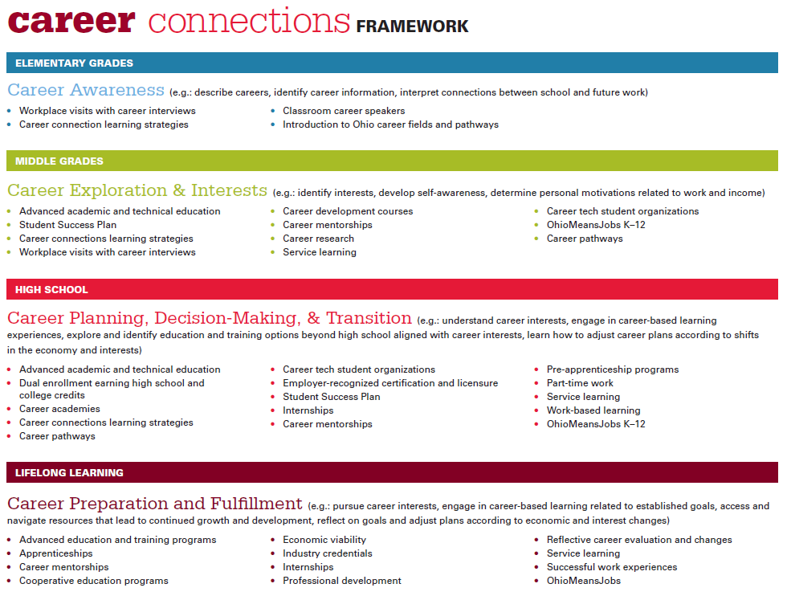
Career Connections Framework

Slide 16
3
Interventions for Students At-Risk of Dropping Out
Notes:
The third component of the policy on career advising is providing additional interventions and career advising to students who are identified as at-risk of dropping out of school.

Slide 17

Student Success Plan
Notes:
Next, districts will develop a student success plan with each student identified as at-risk of dropping out.
A student success plan addresses the student’s academic and career pathway to a successful high school graduation and the role of career-technical education, competency-based education and experiential learning as appropriate.

Slide 18

Model plan for schools to customize
Invite parent to assist
Provide copy and statement to non-participating parents
Parent signature recommended
Notes:
The department has provided a model student success plan with suggested activities for each grade level. Schools may customize the activities based upon student readiness, need and aspiration.
Before starting the plan, district staff must invite the student’s parent, guardian or custodian to assist in developing the plan.
If that adult does not participate, the district will provide them with a copy of the plan and a listing of the pathways to graduation available to the student. That notice should also include a statement of the importance of a high school diploma.
Note that research shows requiring a parent signature on the plan is more likely to engage them and increase the effectiveness of the process.

Slide 19
4
Career Pathways
Notes:
The fourth component of the policy on career advising is providing training for staff on how to advise students on pathways and training on advising students using online tools, such as OhioMeansJobs K-12.

Slide 20
Career Pathways

Slide 21
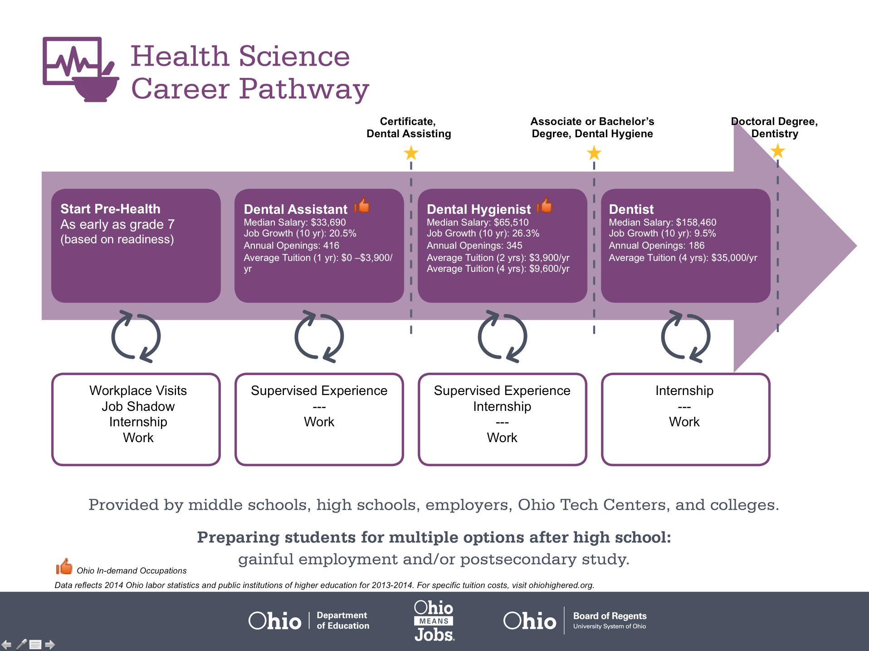
Notes:
Options highlighted in the pathway may include opportunities for students to earn credentials and college credit.

Slide 22
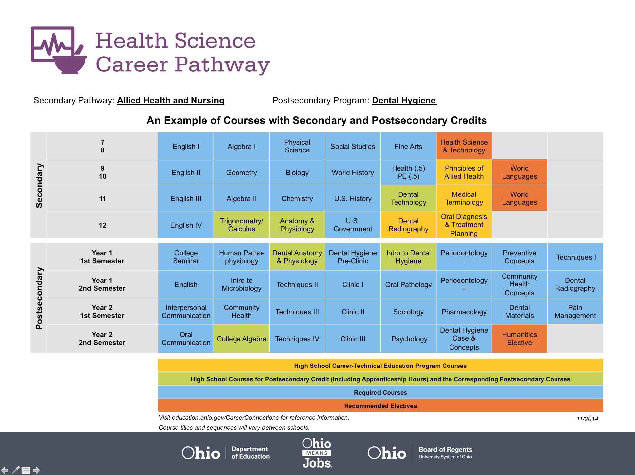
Notes:
Districts may use the pathways provided by the department to offer students examples of the pathways available to earn a high school diploma.

Slide 23
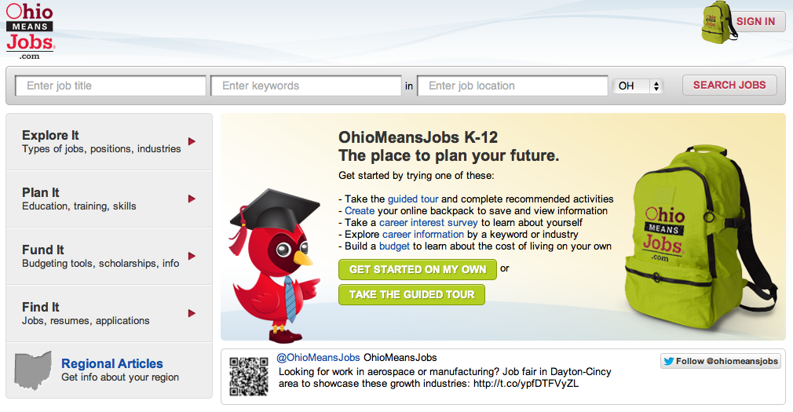
OhioMeansJobs.com
Notes:
Documentation may be satisfied through the OhioMeansJobs K-12 Backpack, as students complete and save activities to their individual account. And reporting tools ☺

Slide 24
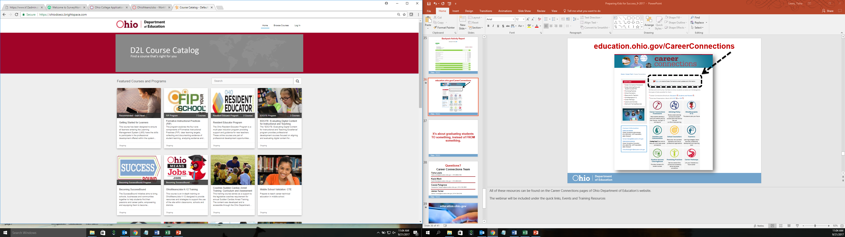
OhioMeansJobs K-12 Training

Slide 25
5
Pathways to Earn a High School Diploma
Notes:
The fifth component of the policy on career advising is providing multiple pathways through high school that students may choose to earn a high school diploma.

Slide 26

Start learning about graduation options in the middle grades
Inform goals and planning
Notes:
Students will begin learning about these options in the middle grades so they may use them to inform their goals and planning.

Slide 27

Three Graduation Options
At least 18 points on state tests
Industry-approved credential and a work-readiness score on WorkKeys
Remediation-free score on ACT or SAT
http://education.ohio.gov/Topics/Ohio-s-Graduation-Requirements
Notes:
Students will begin learning about these options in the middle grades so they may use them to inform their goals and planning.

Slide 28
6
Credit Flexibility – Academic and Career Tech
Notes:
The sixth component of the policy on career advising is providing information to students on courses that can award both traditional academic and career-technical credit.

Slide 29
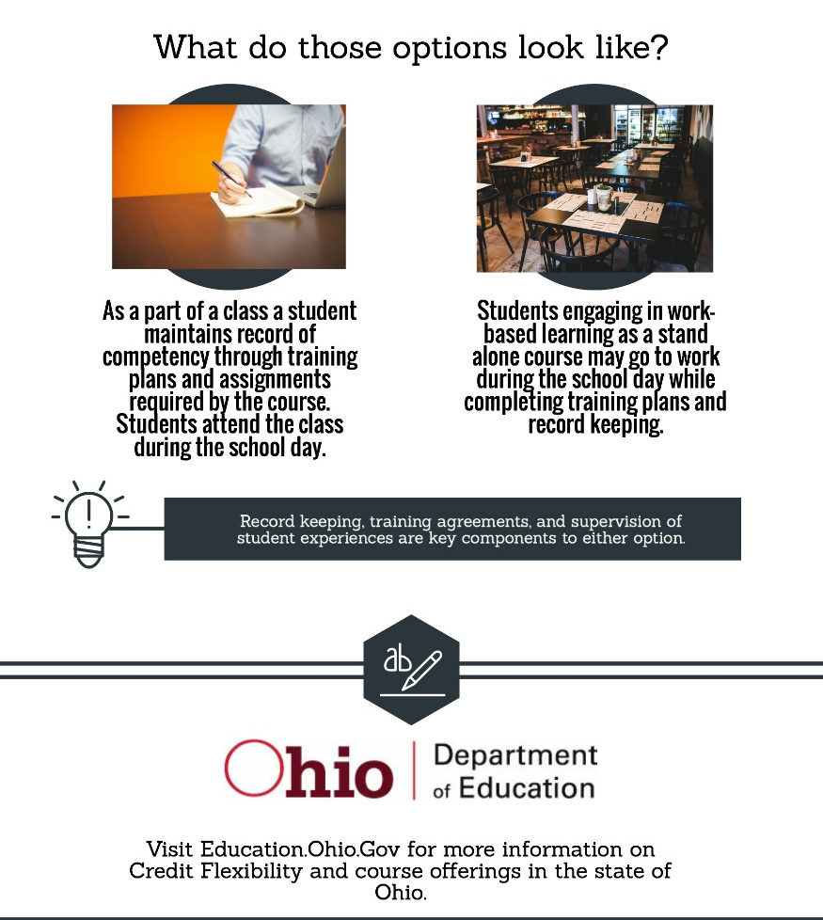

Credit Flex Courses

Slide 30

Integrated Courses
More time in schedule
Relevance
Experiential learning
Notes:
Research supports that students who participate in integrated courses, (1) have more time in their schedule to earn college credit and industry credentials, (2) learn academic content in a relevant context and, (3) can participate in experiential learning.

Slide 31
7
Documentation
Notes:
The seventh component of the policy on career advising is providing documentation on career advising for review by the student, student’s parent, guardian, or custodian, and schools the student may attend in the future.

Slide 32
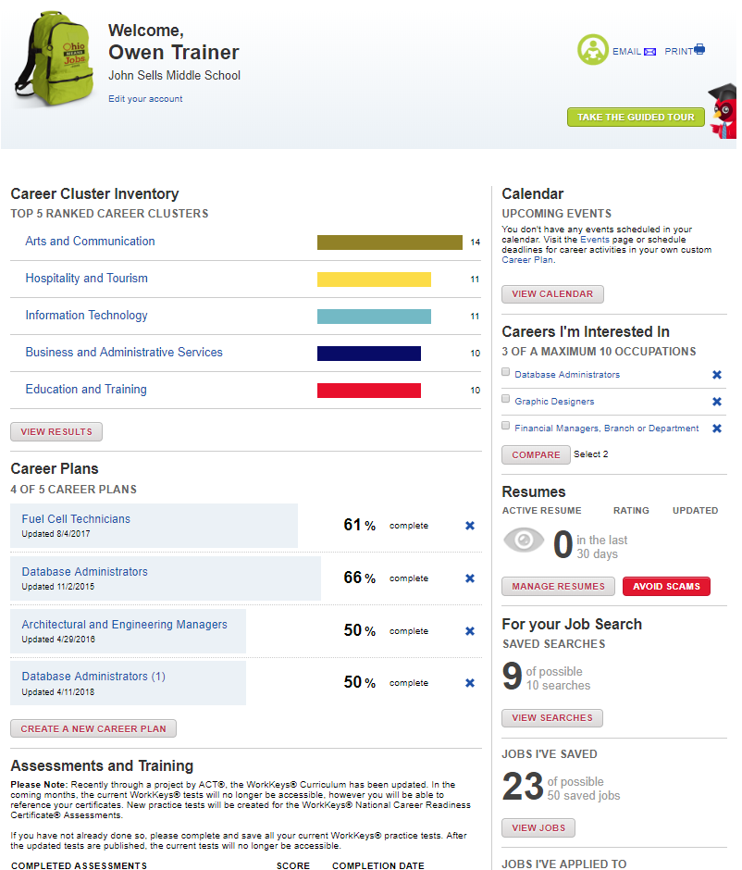
Notes:
Documentation may be satisfied through the OhioMeansJobs K-12 Backpack, as students complete and save activities to their individual account. And reporting tools ☺

Slide 33
8
Successful Postsecondary Transitions
Notes:
The eighth component of the policy on career advising is providing the supports necessary for students to have successful transitions from high school to their postsecondary destinations, including interventions and services for students in need of remediation in mathematics and English language arts.

Slide 34

Interventions for students in need of remediation
Mathematics and English language arts
Notes:
The eighth component of the policy on career advising is providing the supports necessary for students to have successful transitions from high school to their postsecondary destinations, including interventions and services for students in need of remediation in mathematics and English language arts.

Slide 35
It's about graduating students TO something, instead of FROM something.

Slide 36
OhioMeansJobs-Readiness Seal
Kayla Mickens – Ohio Department of Education

Slide 37




OhioMeansJobs-Readiness Seal
Addressing the “soft skills” gap and recognizing Ohio’s work-ready students

Slide 38
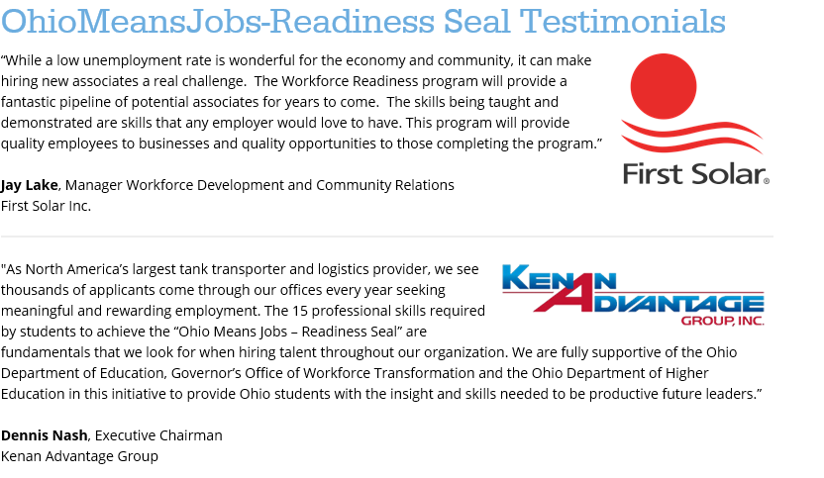
Why?

Slide 39

Background
National Research
Statewide Survey of Business and Industry
Statewide Survey of Secondary and Post-Secondary Education
SuccessBound Workgroups

Slide 40

OhioMeansJobs-Readiness Seal
Methodology
Close the Gap
Common Language
Guidelines and Advising
Identification and Assessment for Hiring
Notes:
The definition and competencies provide for development of strategies and tactics that will close the gap between higher education and the world of work. They lay the foundation for the work necessary to prepare college students for successful entry into the work force.
Source: www.naceweb.org/career-readiness/competencies/career-readiness-resources

Slide 41

Who is the OhioMeansJobs-Readiness Seal for?
A formal designation high school students can earn on their diplomas and transcripts
Shows students have the personal strengths, strong work ethic and professional experience that businesses need.
Available for the graduating classes of 2018 as a graduation option.

Slide 42
OhioMeansJobs-Readiness Seal
15 “Professional Skills”
3+ Mentors
140,600 High School Seniors

Slide 43
OhioMeansJobs-Readiness Seal
Professional Skills
Drug-free pledge
Reliability
Work ethic
Punctuality
Discipline
Teamwork/collaboration
Professionalism
Learning agility
Notes:
This slide shows the 15 professional skills students must demonstrate to earn the seal.
Here’s how we (ODE, OWT, ODHE) determined these 15 skills:
First, we reviewed research conducted by the National Association of Colleges and Employers (NACE) to identify a list of professional skills
We then surveyed Ohio businesses to identify the top 15 skills Ohio businesses consider essential for success at work

Slide 44
OhioMeansJobs-Readiness Seal
Professional Skills
Critical thinking/problem solving
Leadership
Creativity/innovation
Oral and written communications
Digital technology
Global/intercultural fluency
Career management
Notes:
This slide shows the 15 professional skills students must demonstrate to earn the seal.
Here’s how we (ODE, OWT, ODHE) determined these 15 skills:
First, we reviewed research conducted by the National Association of Colleges and Employers (NACE) to identify a list of professional skills
We then surveyed Ohio businesses to identify the top 15 skills Ohio businesses consider essential for success at work

Slide 45
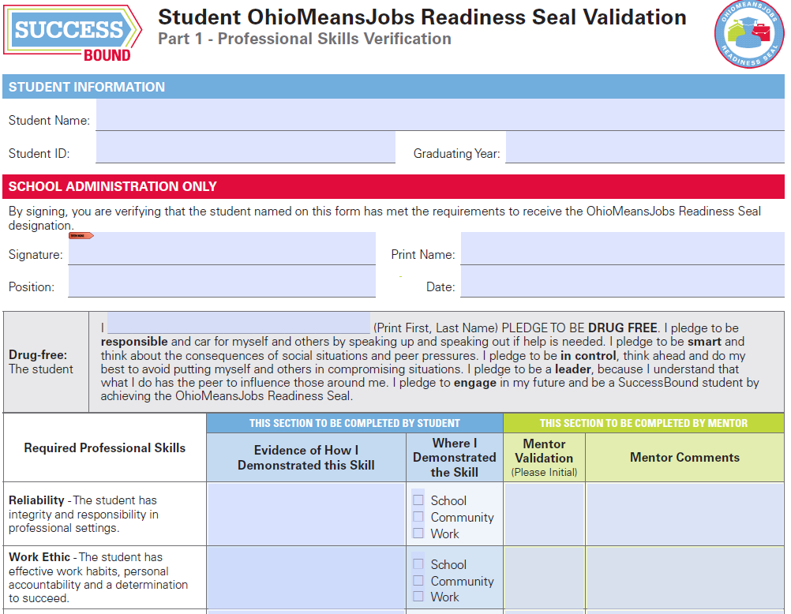
OhioMeansJobs-Readiness Seal
Standardized Form

Slide 46
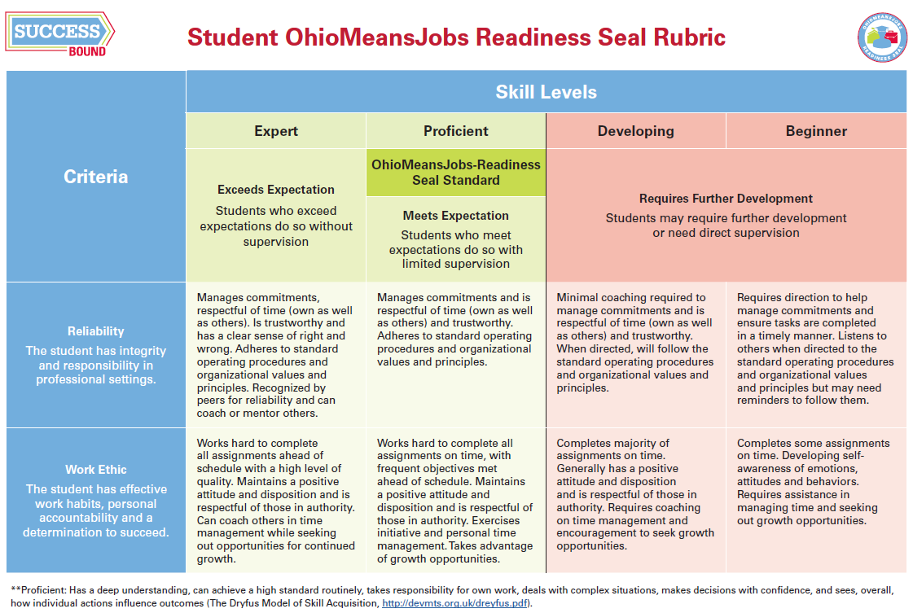
OhioMeansJobs-Readiness Seal
Skills Rubric
Notes:
The OhioMeansJobs-Readiness Seal is available for the graduating classes of 2018 and beyond and will be printed directly on Ohio diplomas and transcripts. The seal also counts toward graduation options for students in the class of 2018.

Slide 47
Validating Student Verification Forms

Slide 48
Validating Student Verification Forms
Meet with the student.
Review evidence provided on the student’s validation form.
Utilize the OhioMeansJobs-Readiness Seal Rubric to help examine evidence provided.

Slide 49
Validating Student Verification Forms
Ensure that student and mentor validation portions are complete.
Contact one or more listed mentors to verify that the student demonstrated the recorded skills under their supervision.

Slide 50
Validating Student Verification Forms
Sign and mark the form completed in the student information system
  Select the Readiness Seal option in the optional graduation requirements module.
Report completion through in-house reporting for graduation and diploma designation.

Slide 51
Validating Student Verification Forms
Assure that EMIS Coordinators know that the OhioMeansJobs-Readiness Seal reporting is within Graduation FY18 Reporting Period G.
Contact the diploma distributor to determine how the OhioMeansJobs-Readiness Seal sticker is affixed to diplomas.

Slide 52
What if a student does not meet the requirements?
The appointed school counselor or administrator should exercise discretion when determining if a student has met the requirements of the OhioMeansJobs-Readiness Seal.
Should it be found that a student has not met the requirements, refer the student to the rubric to identify growth opportunities with their mentors and encourage him or her to resubmit the verification form and any supporting documents.
Notes:
What if a student does not meet the requirements?
The appointed school counselor or administrator should exercise discretion when determining if a student has met the requirements of the OhioMeansJobs-Readiness Seal. Should it be found that a student has not met the requirements, refer the student to the rubric to identify growth opportunities with their mentors and encourage him or her to resubmit the verification form and any supporting documents.

Slide 53
How can a student pursue the OhioMeansJobs-Readiness Seal?

Slide 54
Through their high school
A student can utilize experiences within their high school, volunteer experiences, jobs, etc. to demonstrate the essential professional skills required to meet the Readiness Seal requirements.
Notes:
Can a student complete the mentor requirements through a Career-Technical Education (CTE) program?
Yes. A student can utilize experiences within their CTE program to demonstrate the essential professional skills required to meet the Readiness Seal requirements. However, it is important that the career center communicate with the student’s home school that the student is pursuing the OhioMeansJobs-Readiness Seal through their CTE program.

Slide 55
Adecco Partnership
The Adecco group has come along side ODE to help facilitate work based learning opportunities for students across the state as well as help increase education and business relationships.
For businesses interested or school that would like to strengthen current partnerships by utilizing Adecco’s services I encourage you to visit the SuccessBound page on the Ohio Department of Education’s website or you may contact Tyra Tutor with Adecco at tyra.tutor@adeccogroup.com
Notes:
Can a student independently pursue the OhioMeansJobs-Readiness Seal?
Yes. Students can independently pursue the OhioMeansJobs-Readiness Seal by establishing and working directly with mentors to complete the demonstration of skill and mentor validation sections. However, it is important that students provide each mentor with the informational resources available on the OhioMeansJobs-Readiness Seal page on the Ohio Department of Education’s website. In addition, students should communicate to the appointed school counselor or administrator that he or she is pursuing the OhioMeansJobs-Readiness Seal independently. That student’s appointed school counselor or administrator will still need to complete the final validation of the form and submit the information into the student information system and in-house reporting for graduation and diploma designation.

Slide 56
Through a CTE program
A student can utilize experiences within their CTE program to demonstrate the essential professional skills required to meet the Readiness Seal requirements.
Notes:
Can a student complete the mentor requirements through a Career-Technical Education (CTE) program?
Yes. A student can utilize experiences within their CTE program to demonstrate the essential professional skills required to meet the Readiness Seal requirements. However, it is important that the career center communicate with the student’s home school that the student is pursuing the OhioMeansJobs-Readiness Seal through their CTE program.

Slide 57
Independently
Students may work directly with mentors to complete the demonstration of skill and mentor validation sections.
It’s important for students to inform counselors so they can complete the final validation of the form and submit it.
Notes:
Can a student independently pursue the OhioMeansJobs-Readiness Seal?
Yes. Students can independently pursue the OhioMeansJobs-Readiness Seal by establishing and working directly with mentors to complete the demonstration of skill and mentor validation sections. However, it is important that students provide each mentor with the informational resources available on the OhioMeansJobs-Readiness Seal page on the Ohio Department of Education’s website. In addition, students should communicate to the appointed school counselor or administrator that he or she is pursuing the OhioMeansJobs-Readiness Seal independently. That student’s appointed school counselor or administrator will still need to complete the final validation of the form and submit the information into the student information system and in-house reporting for graduation and diploma designation.

Slide 58
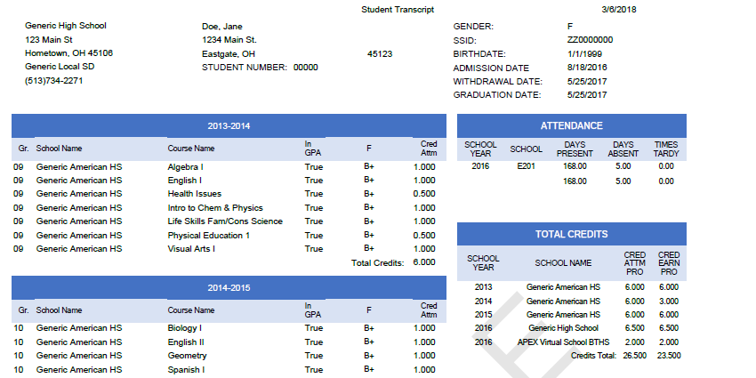
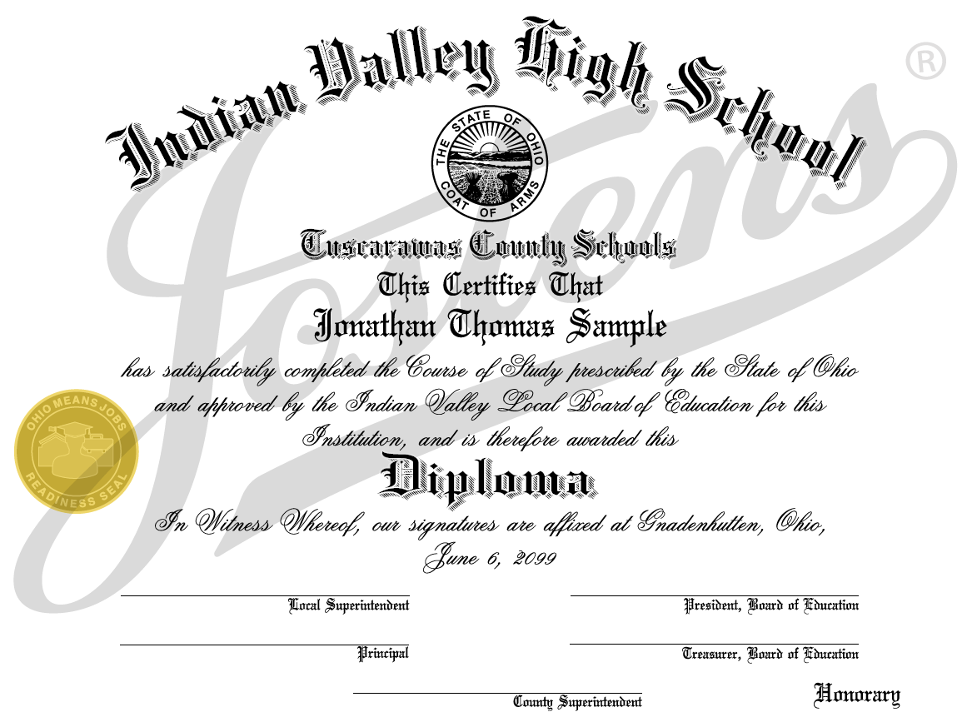
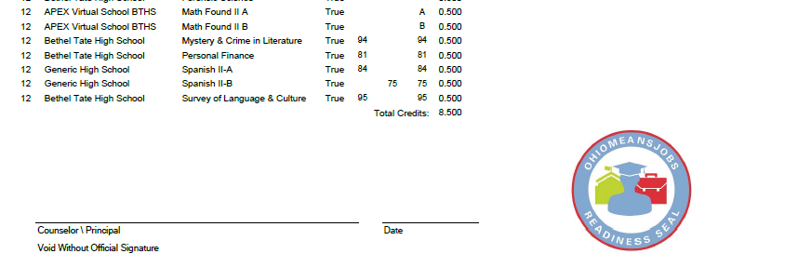
OhioMeansJobs-Readiness Seal
Transcripts & Diplomas
Notes:
The OhioMeansJobs-Readiness Seal is available for the graduating classes of 2018 and beyond and will be printed directly on Ohio diplomas and transcripts. The seal also counts toward graduation options for students in the class of 2018.

Slide 59











OhioMeansJobs-Readiness Seal
Industry Support
Notes:
A main priority moving forward is continuing to grow our list of industry support. This will ensure that students who graduate with the seal will see a “return” on their investment of time and effort to earn the seal. The purpose of our business support list is to inspire other businesses to recognize the seal, but more importantly, to give students a list of companies throughout the state that will recognize their work-readiness.
All the companies on this slide have committed to training their HR teams to recognize students who earn the seal as having a competitive advantage. Most have also submitted 2-3 sentence testimonials from an executive at the company about the value of the Seal to them as an employer.
Our challenge to you (the audience): please continue to spread the word to your business partners. If you talk to business leaders who support this, request that they contact us to provide a testimonial.

Slide 60
Guidance and Tools
OhioMeansJobs-Readiness Seal
To learn more, visit education.ohio.gov and search “OhioMeansJobs-Readiness Seal”
Kayla Mickens
Ohio Department of Education
Kayla.Mickens@education.ohio.gov
(614) 466-4235
Emily Modell
Governor’s Office of Workforce Transformation
Emily.Modell@owt.ohio.gov
(614) 644-9347
Notes:
To learn more, visit Education.Ohio.gov and search “OhioMeansJobs-Readiness Seal.”
Thought-provoking questions for Q&A:
How are you currently encouraging your students to pursue the Readiness Seal?
What steps are you taking to help all students achieve the seal?
What obstacles have you faced so far?

Slide 61
Business Advisory Councils
James Turner

Slide 62

Background and Requirements
BACs originally established under ORC 3313.174
ORC 3313.82 requires all districts to have a BAC
A district may leverage the BAC of an ESC
Notes:
[When presenting, this slide requires multiple clicks to reveal each element]

Slide 63
Responsibilities (ORC 3313.82)
Employment skills and curriculum
Changes in economy, job market, employment and future jobs
Relationships among businesses, labor organizations, and education

Slide 64

Additional Requirements
Building Ohio’s Future Workforce report
9 of 20 items aligned to BAC requirements under ORC 3313.82
ORC Section 3313.821 as part of Am. Sub. H.B. 49
Notes:
[When presenting, this slide requires multiple clicks to reveal each element]

Slide 65
Additional Requirements
BACs must establish a plan
BACs must file the plan
BACs must meet quarterly
BACs must publish a joint statement Statement
Notes:
[When presenting, this slide requires multiple clicks to reveal each element]

Slide 66
Implementation Timeline
Date: 6/30/18
Districts establish BACs
Date:3/1/19
Publish joint statement
Date: 12/31/17
Publish operating standards to districts
Date: 9/30/18
Develop and submit BAC plan to ODE
Notes:
[When presenting, this slide requires multiple clicks to reveal each element]

Slide 67

Considerations
Member Selections
Operations
COIs
Sunshine Laws Council Size
Terms of Service
Orientation
ID District POC
Officers
Meetings
Subcommittees
Bylaws
Notes:
[When presenting, this slide requires multiple clicks to reveal each element]

Slide 68
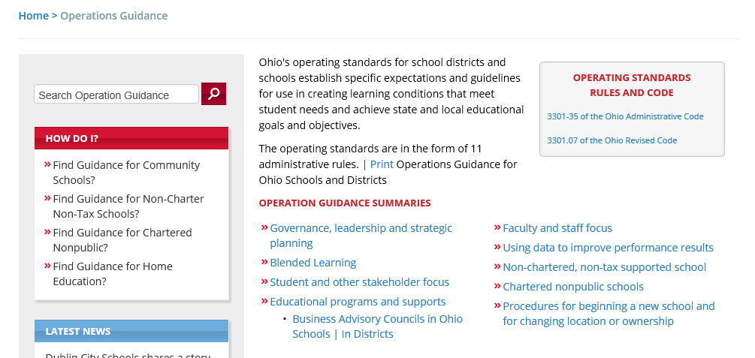
Operating Standards
The operating standards for Business Advisory Councils in Ohio Schools can be found here: education.ohio.gov/topics/operating-standards

Slide 69




Join the Conversation
OHEducation
OHEducation
OhioOWT
@OHEducation
@OHEducationSupt
@OhioOWT
OhioEdDept

